Slide 1
GraphicsControls
Drawn Controls

Slide 2

Javier Suárez
Hi!. Mi name is Javier, I work in the Xamarin.Forms and .NET MAUI team at Microsoft. I love participating in technical communities and I am the coordinator of the SevillaDotNet and SVQXDG groups in Seville. You can contact me:
@jsuarezruiz
javiersuarezruiz@hotmail.com
https://javiersuarezruiz.wordpress.com

Slide 3

Do not hesitate to ask!

Slide 4
Experimental

Slide 5
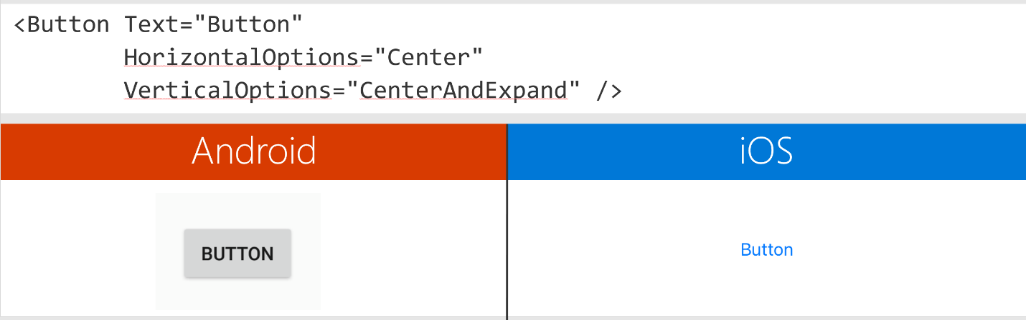
Feedback received
Consistent look and behavior.
Easy way to extend and customize.
The Visual Material implementation is consistent, but rigid in its prescriptive design which doesn’t match some customer designs.

Slide 6
System.Graphics
System.Graphics is a cross-platform graphics library for iOS, Android, Windows, macOS, Tizen and Linux completely in C#. With this library you can use a common API to target multiple abstractions allowing you to share your drawing code between platforms, or mix and match graphics implentations within a singular application.

Slide 7
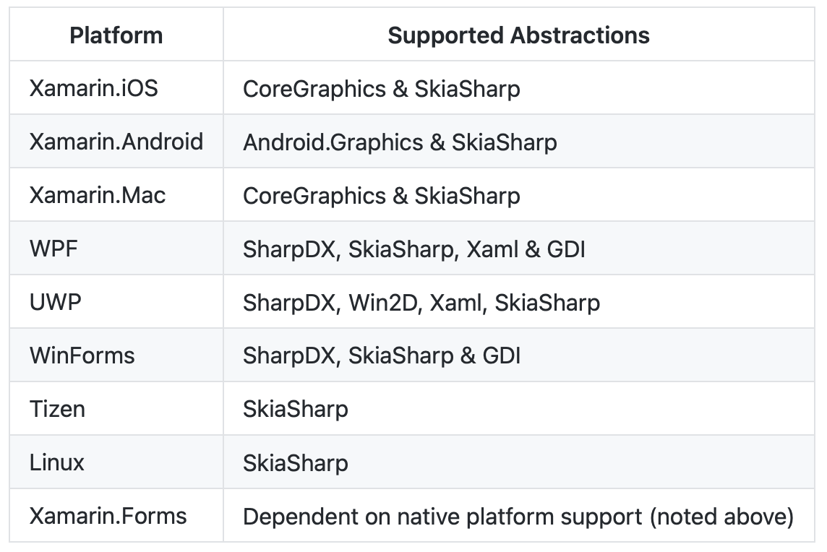
System.Graphics: Supported platforms

Slide 8
DEMO: System.Graphics

Slide 9
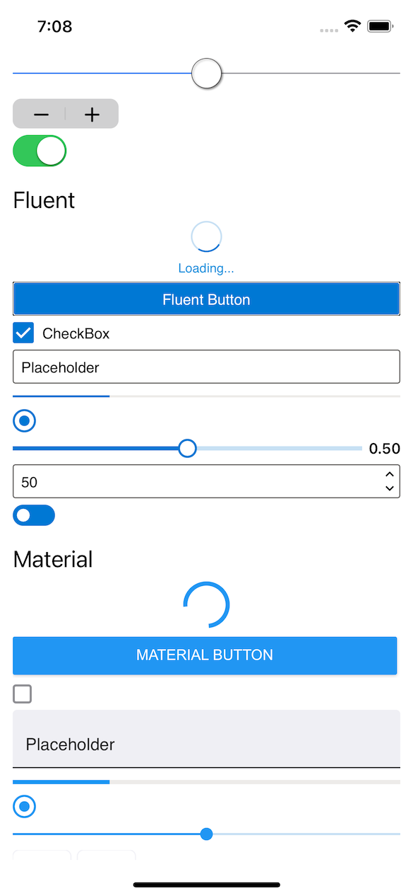
GraphicsControls
GraphicsControls is a library that offers the controls available in Xamarin.Forms Visual allowing to choose between Cupertino, Fluent and Material but, instead of creating native controls, are drawn controls.
This project is a .NET experiment related to Xamarin / .NET MAUI with different tests to validate the interest and feasibility of drawn controls but is not covered by Microsoft support.

Slide 10
GraphicsControls
Available controls:
ActivityIndicator (Cupertino, Fluent, Material)
BoxView
Button (Cupertino, Fluent, Material)
CheckBox (Cupertino, Fluent, Material)
DatePicker (Cupertino, Fluent, Material)
Editor (Cupertino, Fluent, Material)
Entry (Cupertino, Fluent, Material)
Frame
ProgressBar (Cupertino, Fluent, Material)
RadioButton (Cupertino, Fluent, Material)
Slider (Cupertino, Fluent, Material)
Stepper (Cupertino, Fluent, Material)
Switch (Cupertino, Fluent, Material)
TimePicker (Cupertino, Fluent, Material)

Slide 11
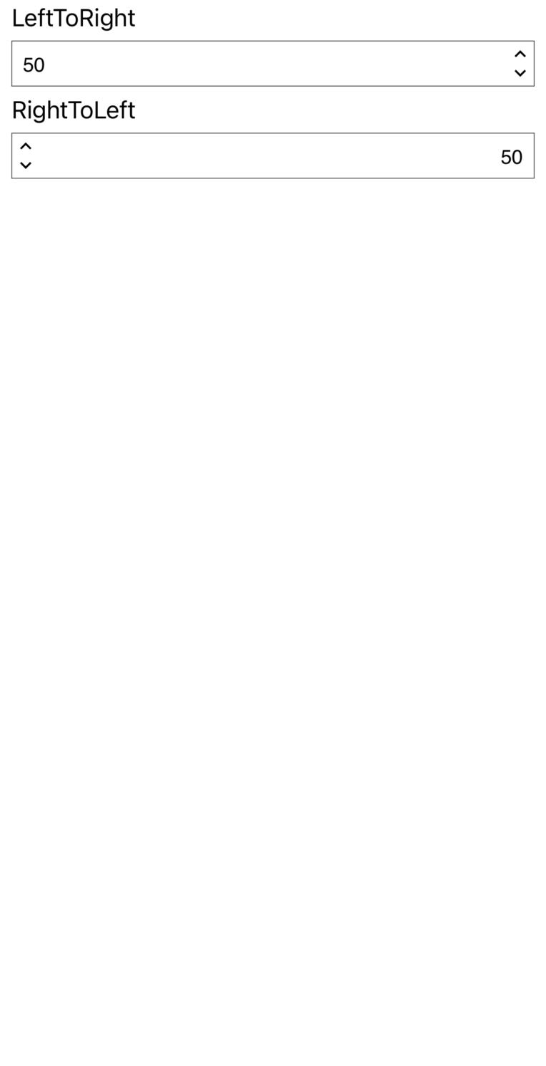
GraphicsControls
Features:
Pixel perfect drawn and same behavior in all the platforms.
RTL support.
Accesibility support.
Themes support.
Phone and Desktop support.

Slide 12
DEMO: GraphicsControls

Slide 13
Extend GraphicsControls controls
public class CustomControl : GraphicsView
{
public override void Draw(ICanvas canvas, RectangleF dirtyRect)
{
base.Draw(canvas, dirtyRect);
}
}
public class CustomSlider : Slider
{
protected override void DrawSliderThumb(ICanvas canvas, RectangleF dirtyRect)
{
base.DrawSliderThumb(canvas, dirtyRect);
}
}

Slide 14
GraphicsControls. Next steps.
Continue mapping and completing properties.
Adapt controls to .NET MAUI Handlers.
Include the DrawMapper concept from Comet.
Include XAML extensibility options (based on DrawMapper).
public static DrawMapper<ProgressBar> ProgressBarDrawMapper = new DrawMapper<ProgressBar>(SkiaControl.DrawMapper)
{
[Slider.Layers.Track] = DrawTrack,
[Slider.Layers.Progress] = DrawProgress
};

Slide 15

GraphicsControls. Feedback.
https://github.com/dotnet/GraphicsControls/issues/1

Slide 16
Questions?

